Slide 1
Coping with Worry

Slide 2
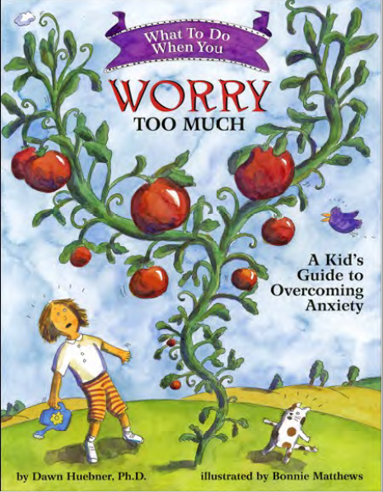

Slide 3
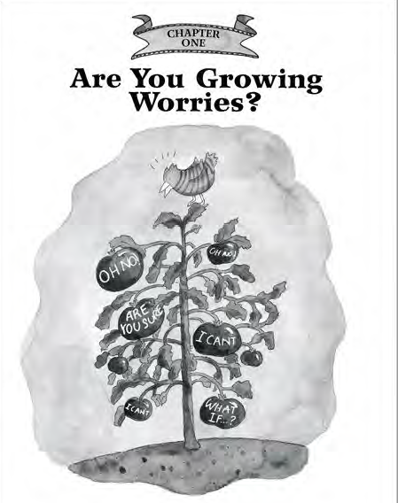

Slide 4
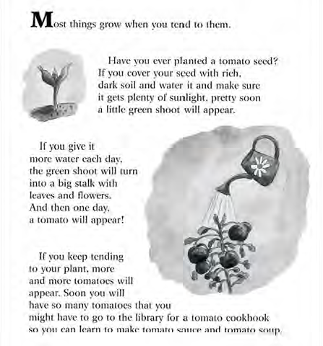

Slide 5
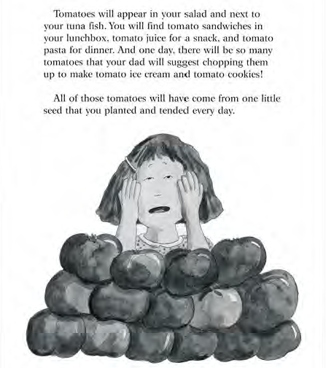

Slide 6
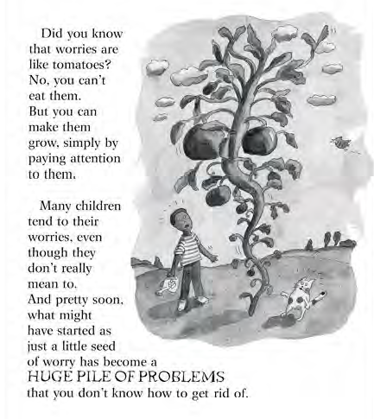

Slide 7
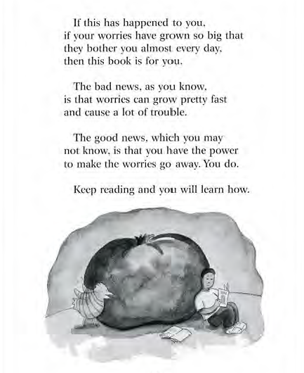

Slide 8
All Feelings are Normal!
We all have feelings! Children, teenagers, and adults all feel many different emotions.
All feelings are OK! Anger, sadness, embarrassment, happiness- they are all normal.
What is important is what we DO when we have these feelings.

Slide 9
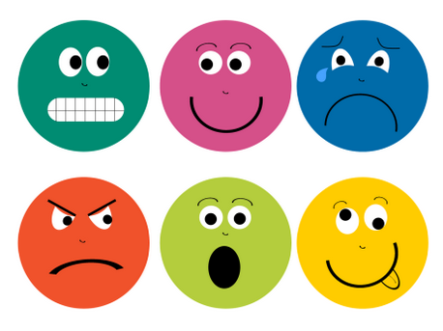
How are YOU feeling today?
Happy
Sad
Mad
Worried

Slide 10
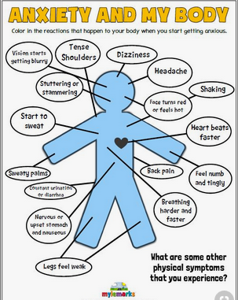
How Does Your Body Feel When You’re Worried?

Slide 11

What can we do when we’re worried?
Move our bodies and exercise!
  GoNoodle and Cosmic Kids Yoga are great indoor options.
Talk to someone.
  It can be helpful to use I feel statements: “I feel ____________ because ________________.” (For example, I feel worried because I have a test tomorrow.)
Take deep breaths.
Listen to calm music.
Draw or write.
Do another hobby that you enjoy.

Slide 12

Books
How Big Are Your Worries Little Bear? By Jayneen Sanders
Hey Warrior! By Karen Young
The Huge Bag of Worries by Virginia Ironside
When My Worries Get Too Big by Kari Dunn Buron
What to Do When You Worry Too Much by Dawn Huebner
It’s Okay to Make Mistakes by Todd Parr
Wilma Jean the Worry Machine by Julia Cook
David and the Worry Beast by Anne Marie Guanci
When Worry Takes Hold by Liz Haske
100th Day Worries by Margery Cuyler
Many books can be found for free on the library apps Hoopla or Overdrive, or sometimes can be found in video format on YouTube.

Slide 13
Thank you!

